Slide 1

MAVERICK BANK
Presented by: Thevaashree MKS
Trainer: Javeed sir

Slide 2
Technologies And Tools
Frontend: React.js Used to build a responsive and interactive UI for customers, employees, and administrators. Provides routing, form validations, and seamless integration with backend APIs.
Backend: Java (Spring Boot) Handles business logic, services, and REST API development. Ensures scalability, modularity, and secure communication with the database.
Database: MySQL Stores customer, account, transaction, and loan details securely. Supports relational queries, reporting, and financial data management.
Authentication: JWT (JSON Web Token) Provides secure login and access control for different user roles. Tokens ensure only authorized users can access sensitive APIs.
Tools: Eclipse, MySQL Workbench, Postman, GitHub Eclipse for coding and debugging, MySQL Workbench for database design. Postman for API testing and GitHub for version control and collaboration.

Slide 3
About
Brief Overview: Maverick Bank is a comprehensive banking and financial system that allows customers
to manage accounts, perform transactions, apply for loans, and generate reports.
Bank employees can validate accounts, approve loans, and monitor transactions.
Administrators manage users and employees.
Scope & Modules:
Customer: Register, Login, Manage Accounts, Transactions, Apply Loan, Generate Reports
Bank Employee: Approve Accounts, View Transactions, Manage Loans, Generate Reports
Administrator: Manage users and employees
Security: JWT authentication & authorization

Slide 4
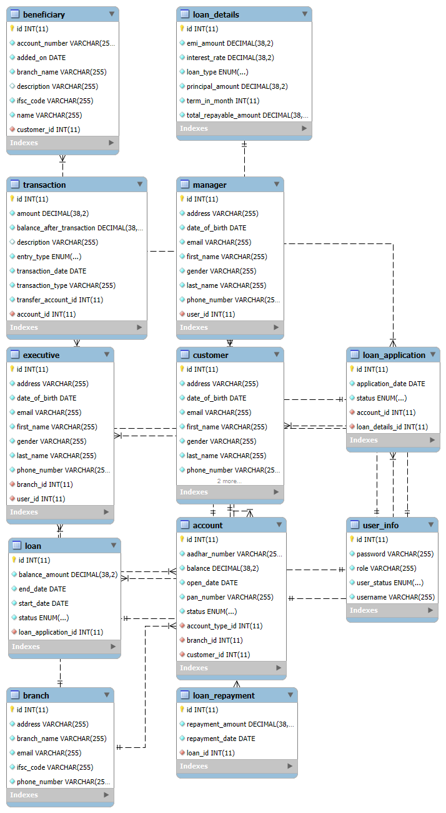
ER DIAGRAM

Slide 5
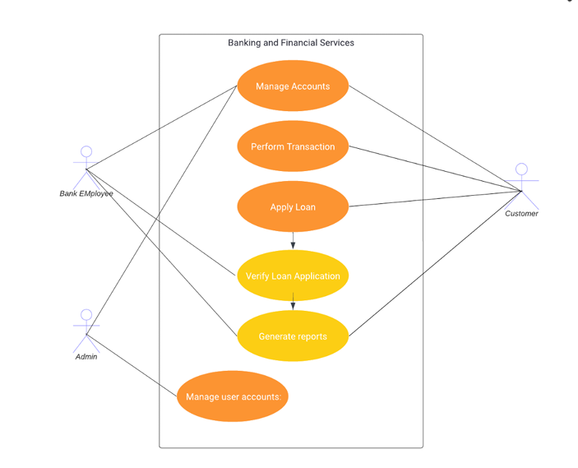
USE CASE DIAGRAM

Slide 6
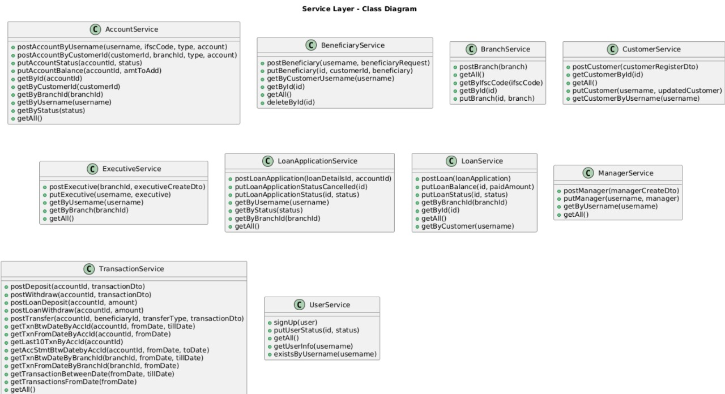

Slide 7
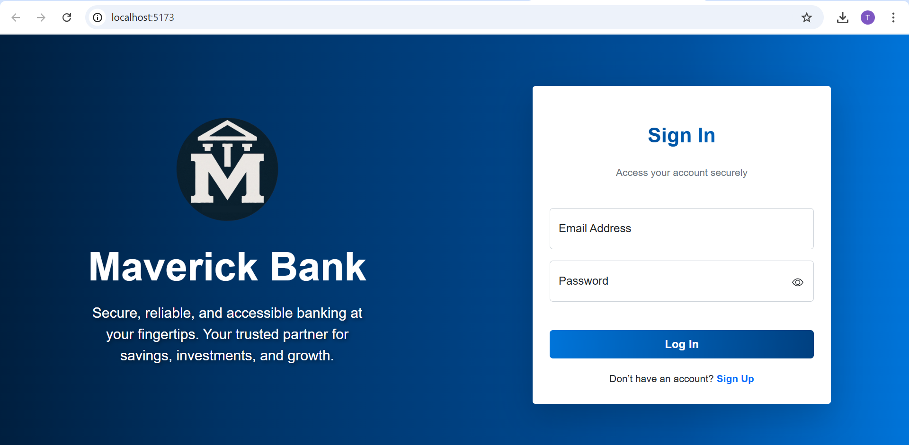
Project Screenshots

Slide 8
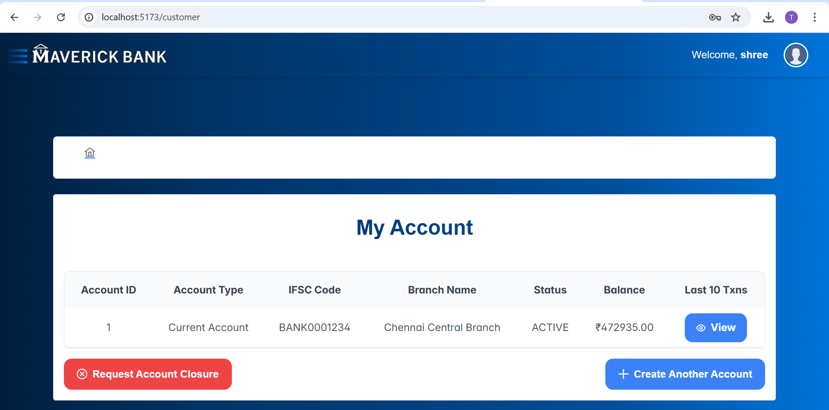

Slide 9
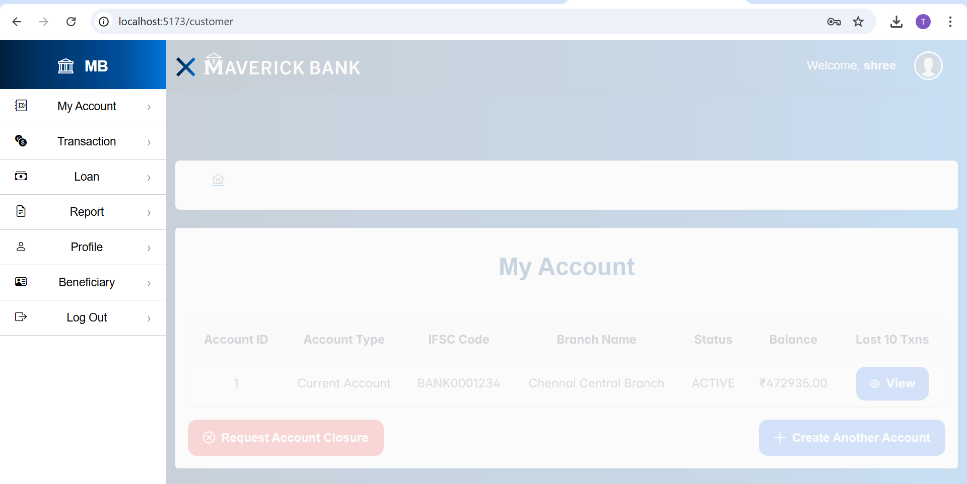

Slide 10
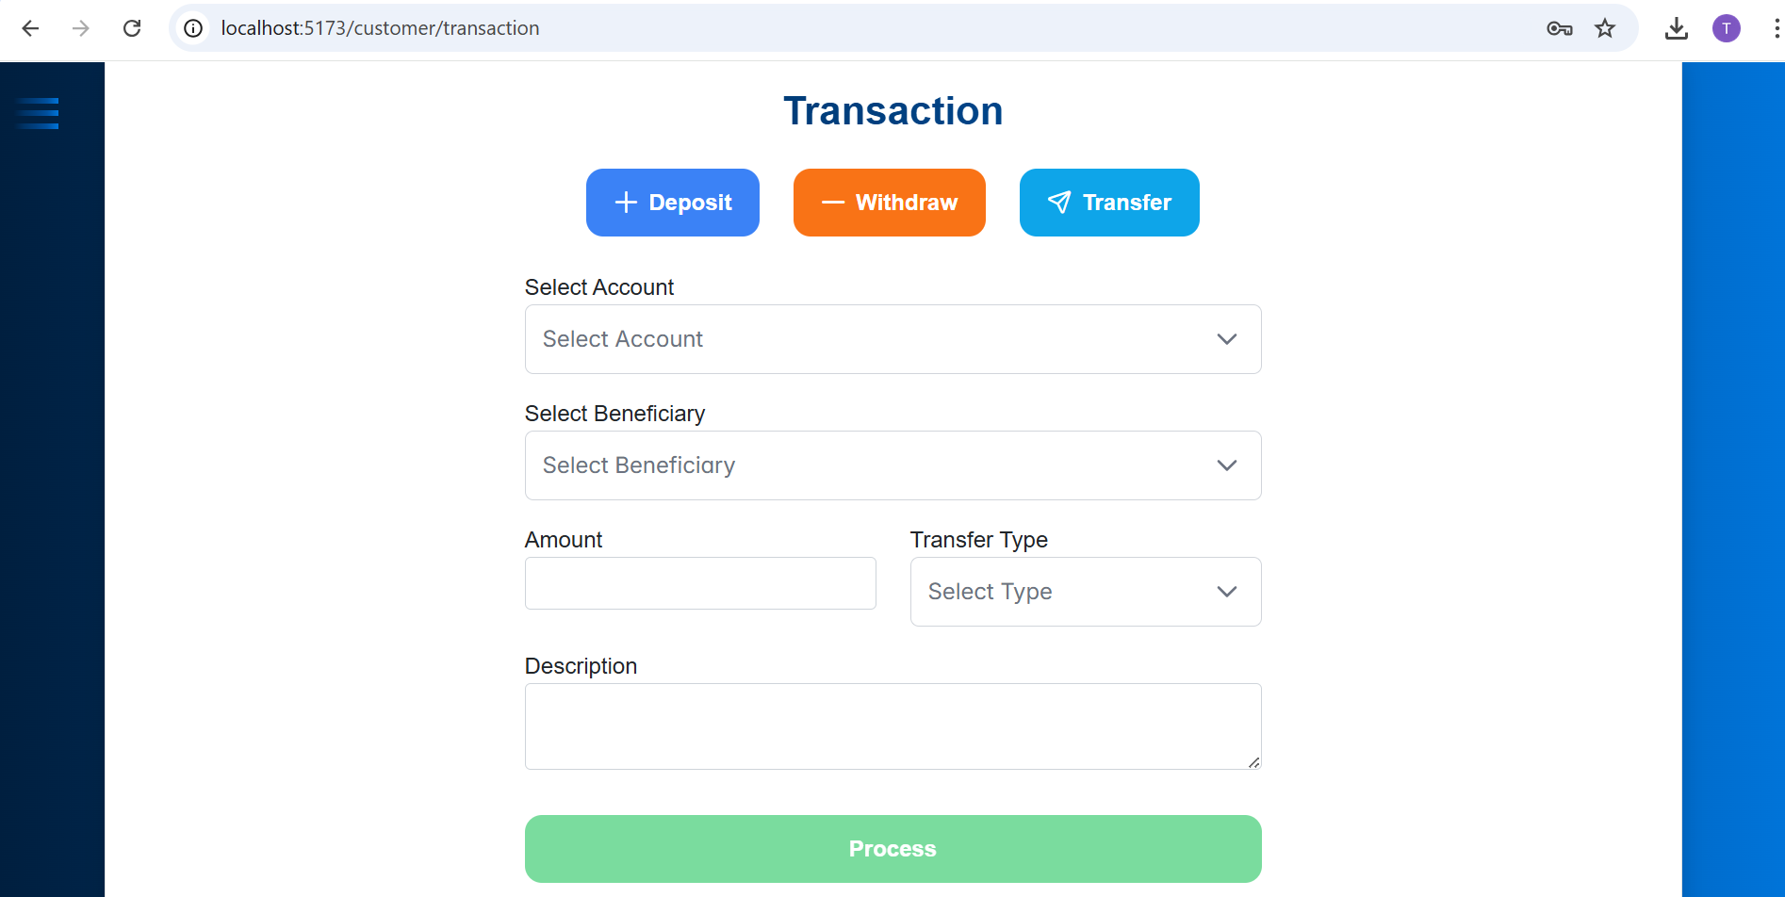

Slide 11
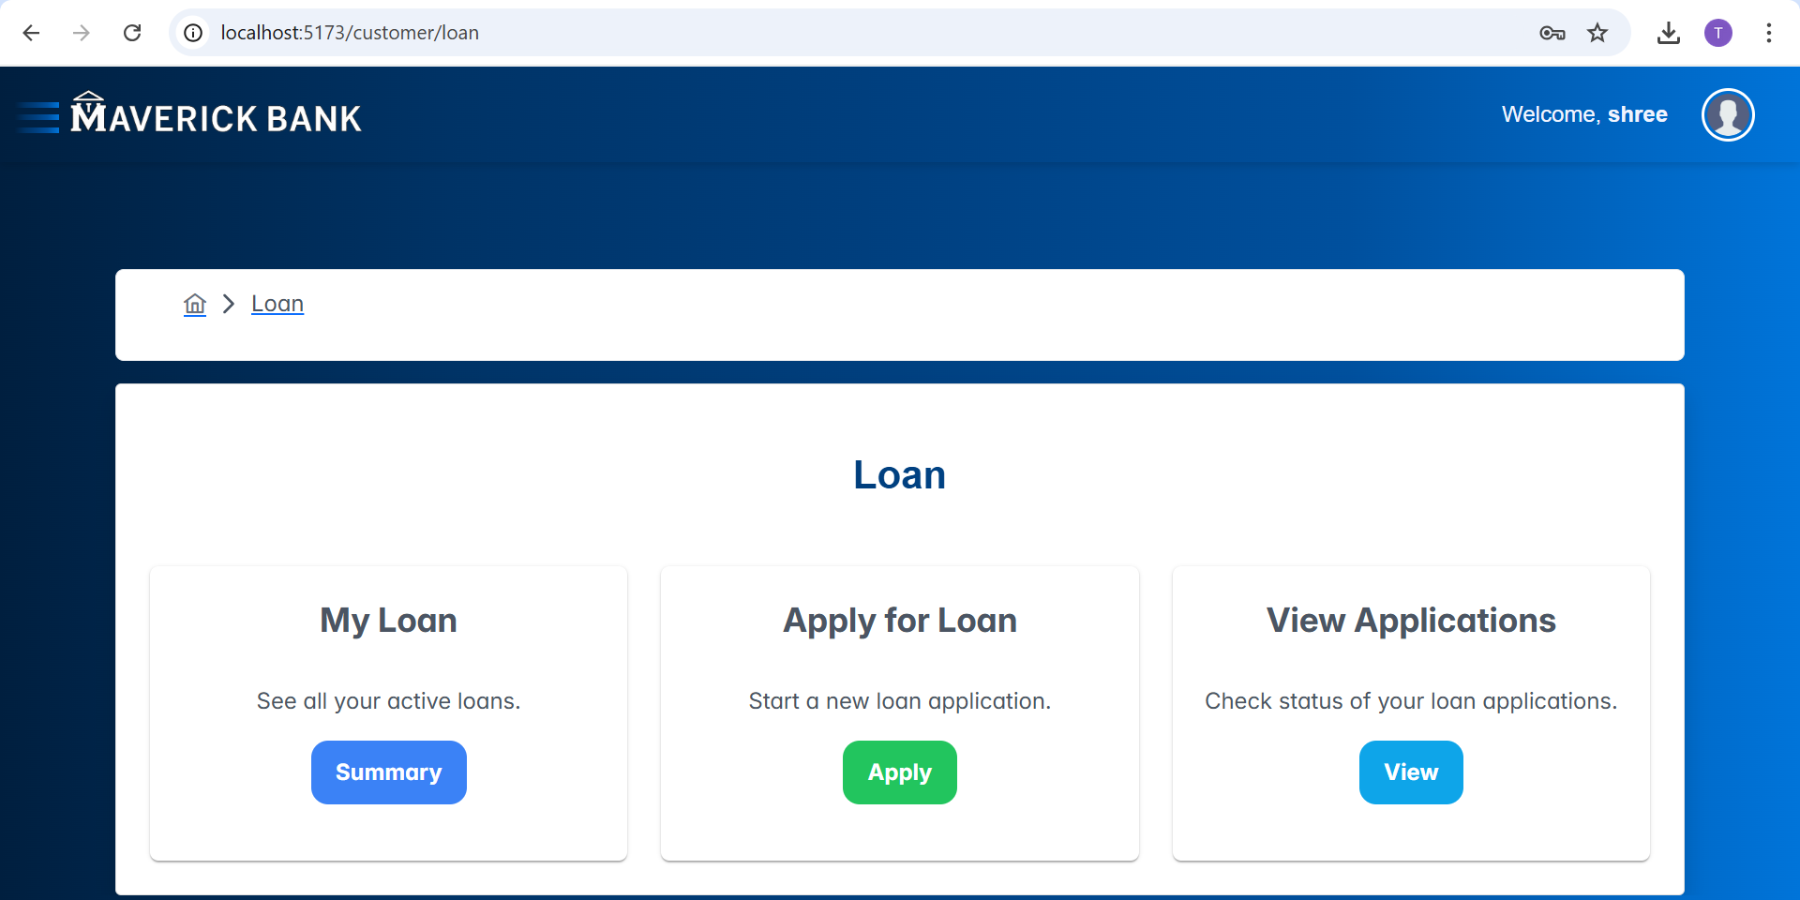

Slide 12
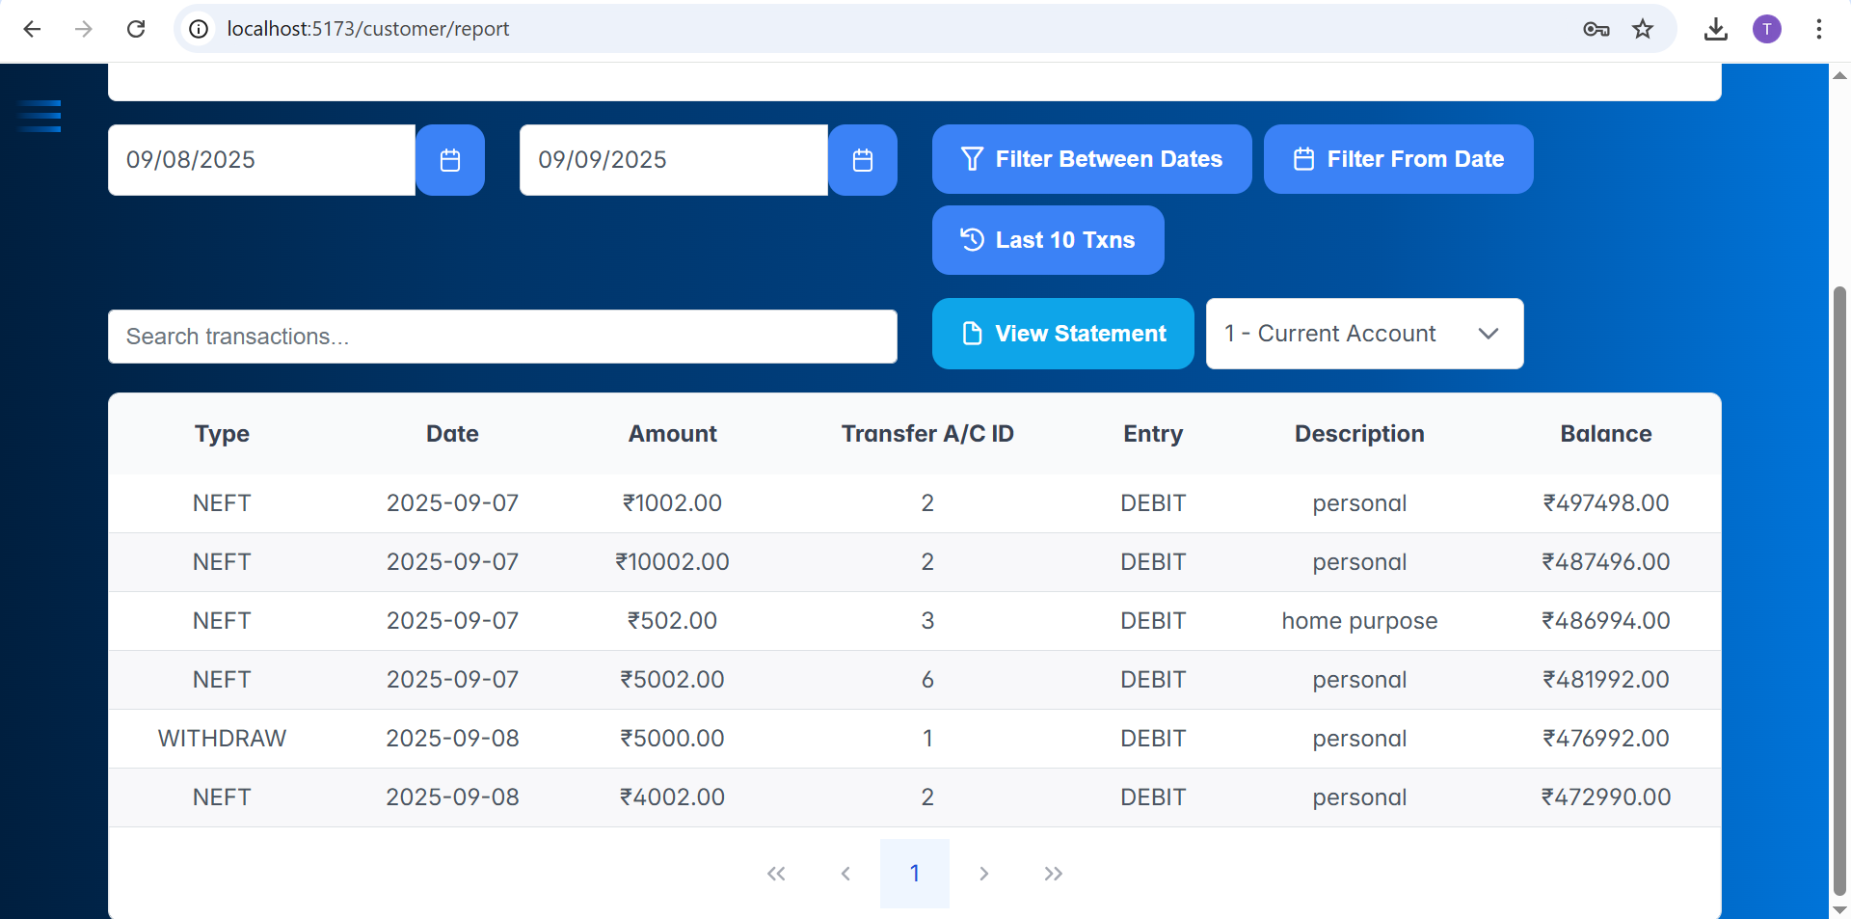

Slide 13
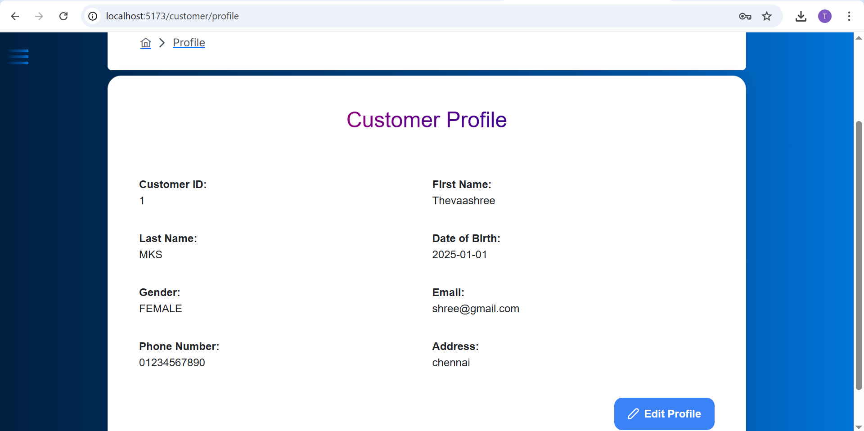

Slide 14
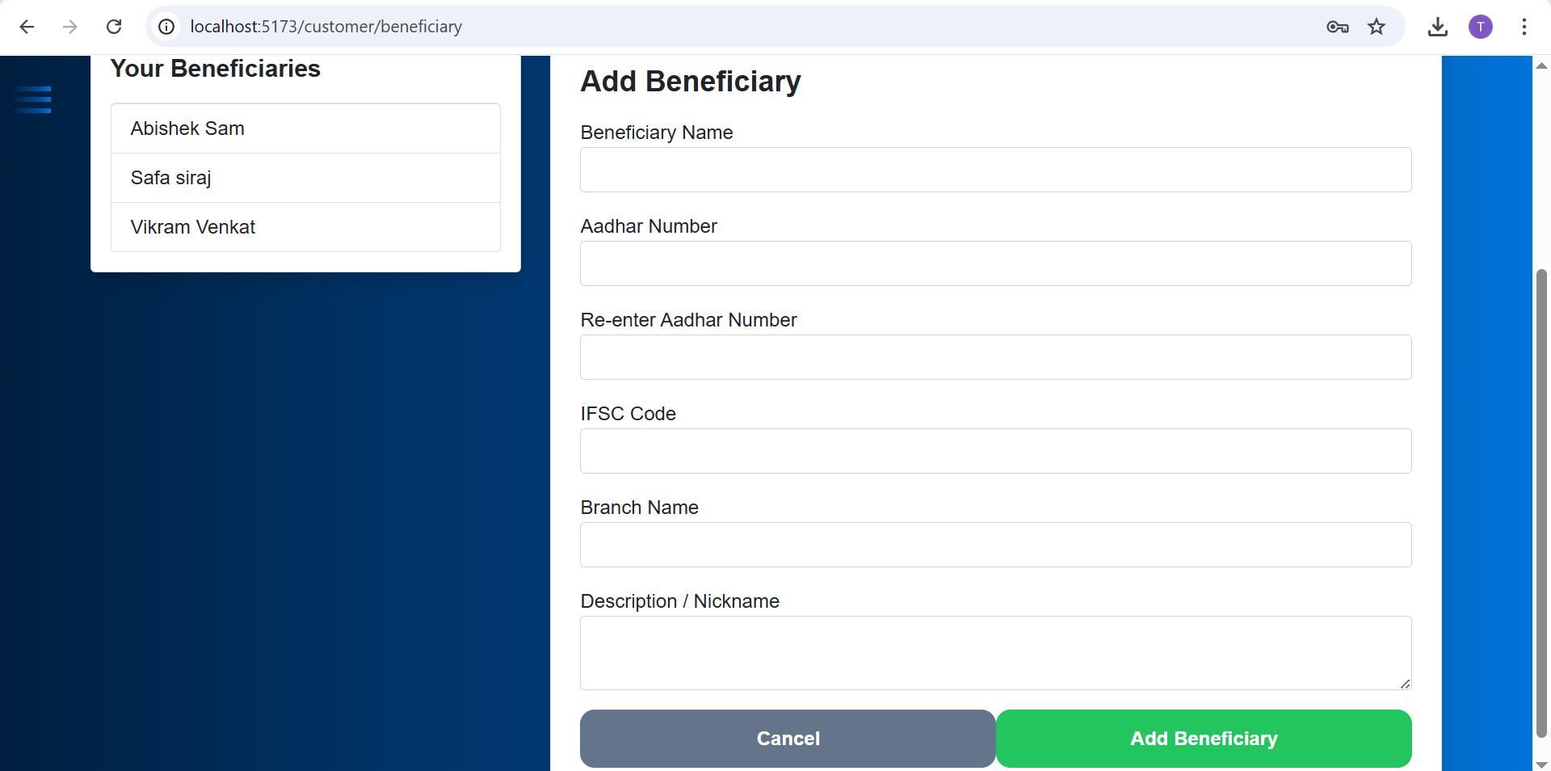

Slide 15
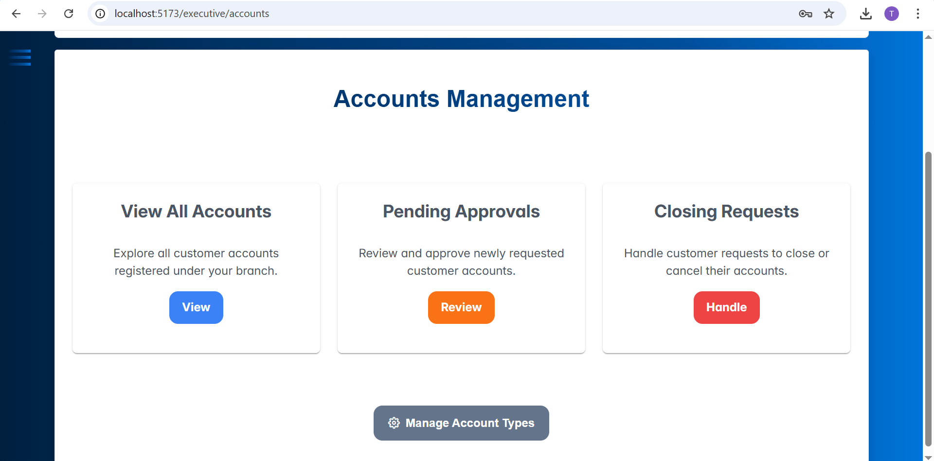

Slide 16
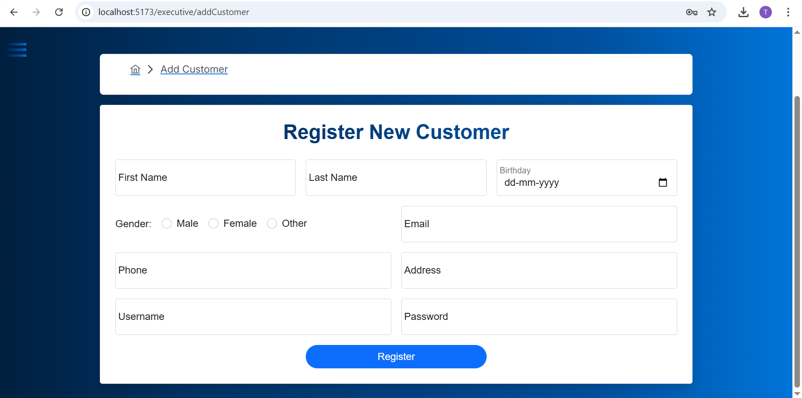

Slide 17
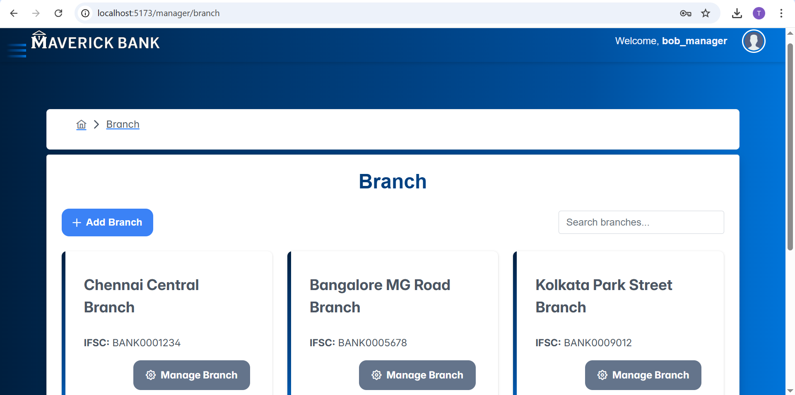

Slide 18
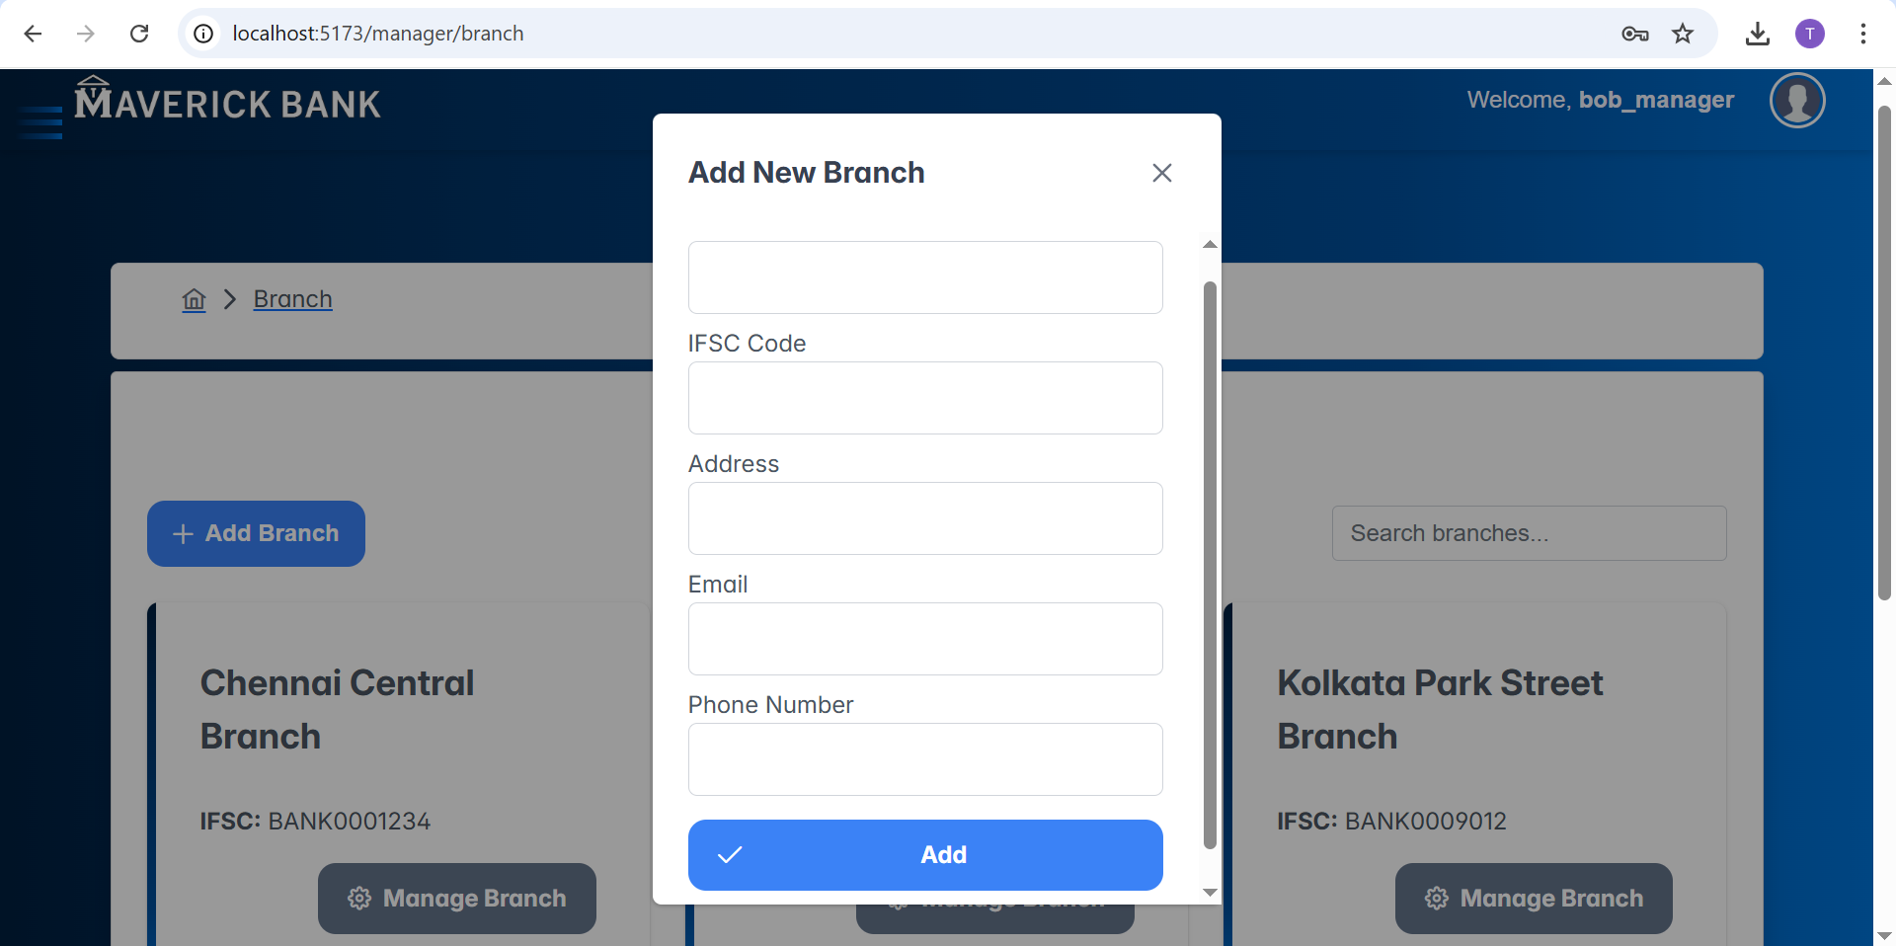

Slide 19
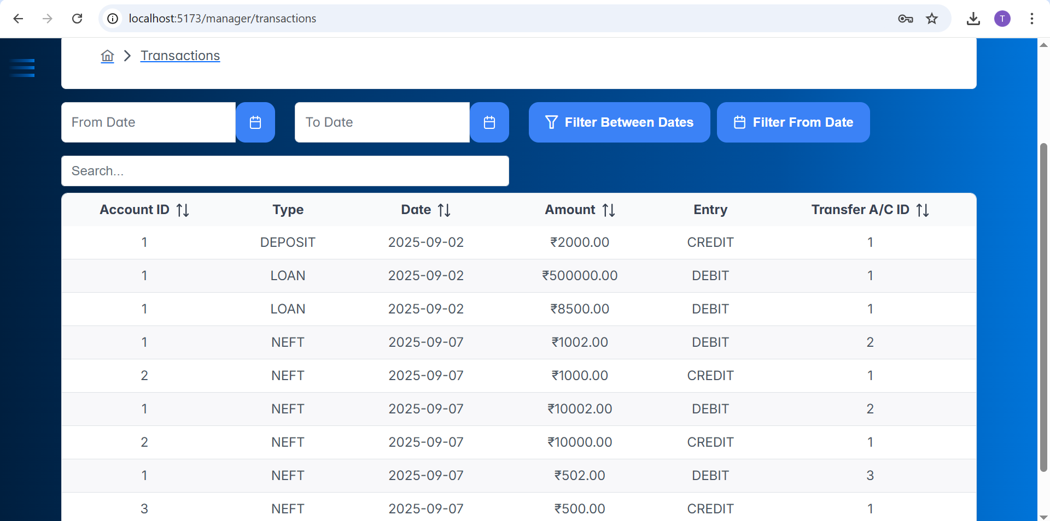

Slide 20

THANK YOU!

